Slide 1
Google Play Store EDA
To find the factors influencing high app install count.
Narendra - INSAID Mar 2019 Cohort
Notes:
Google play store EDA

Slide 2
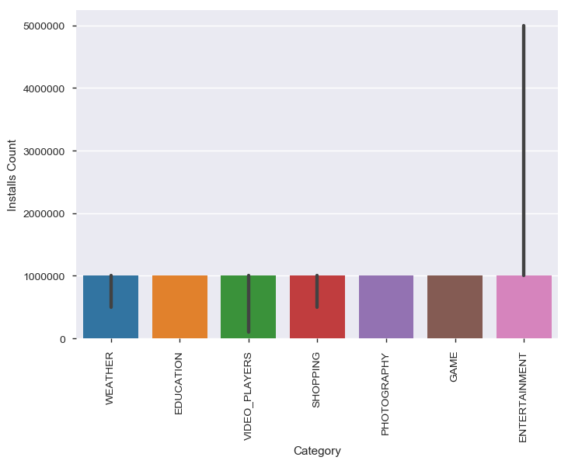
Top downloaded categories

Slide 3
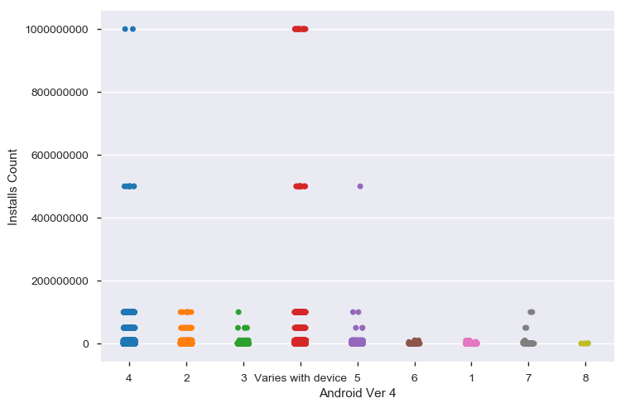
OS Support to download count

Slide 4
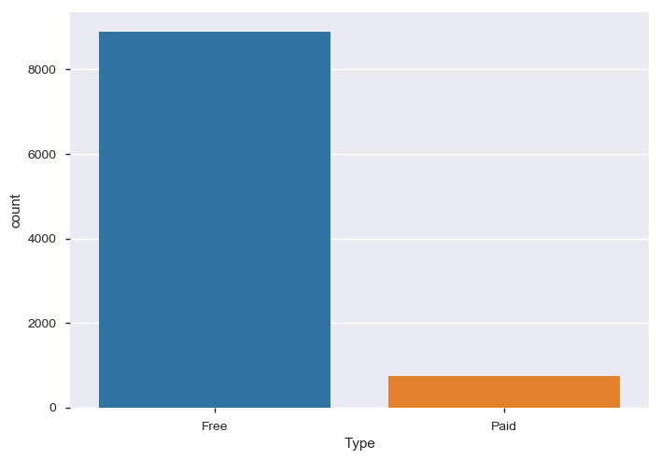
App pricing

Slide 5
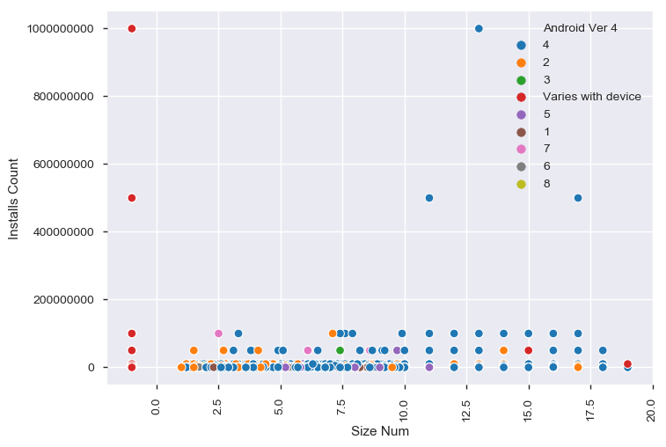
Influence of app size

Slide 6
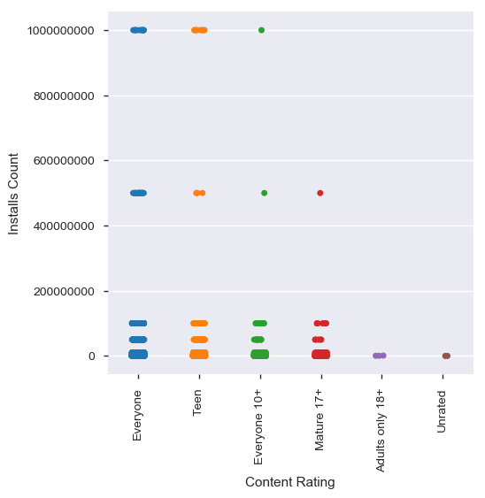
Influence of content rating

Slide 7
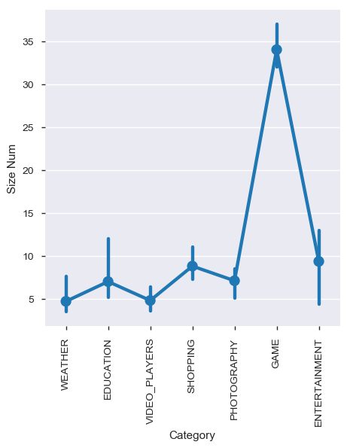
Sizes of app from top categories

Slide 8
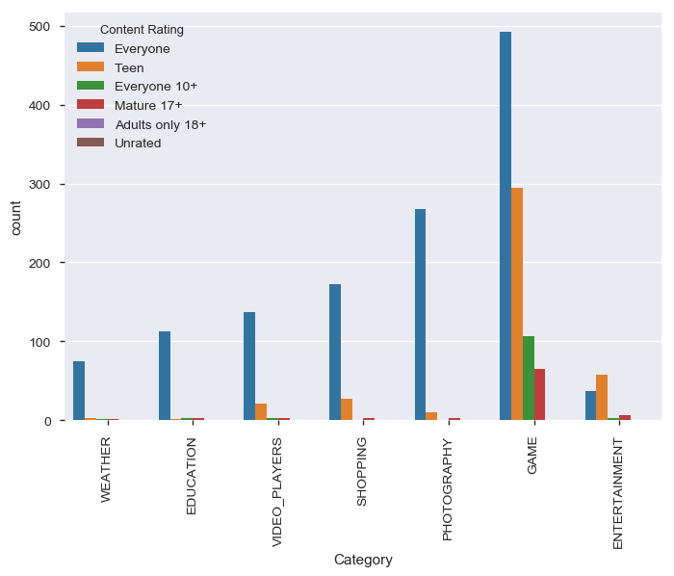
Content rating of top categories

Slide 9
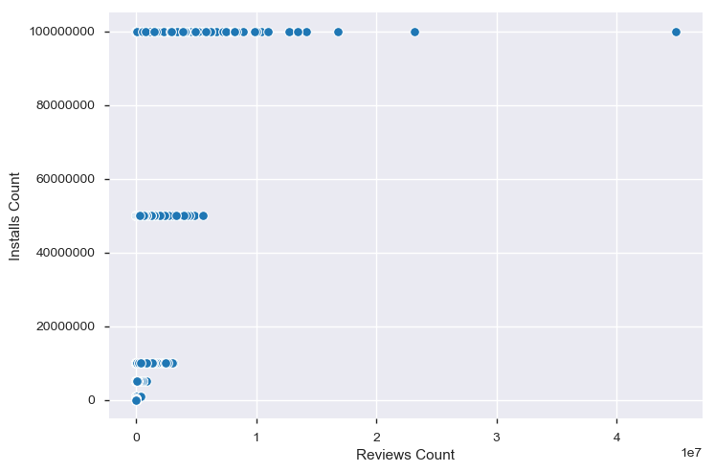
Influence of review counts

Slide 10
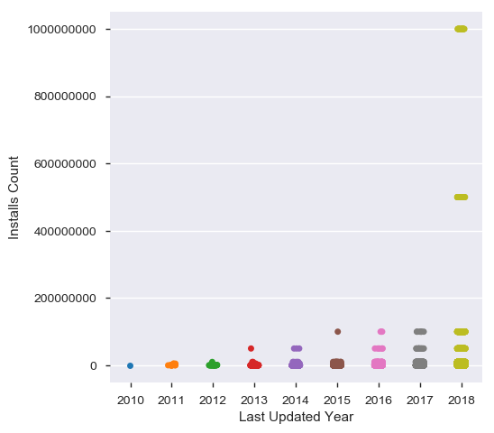
Influence of last updated time

Slide 11
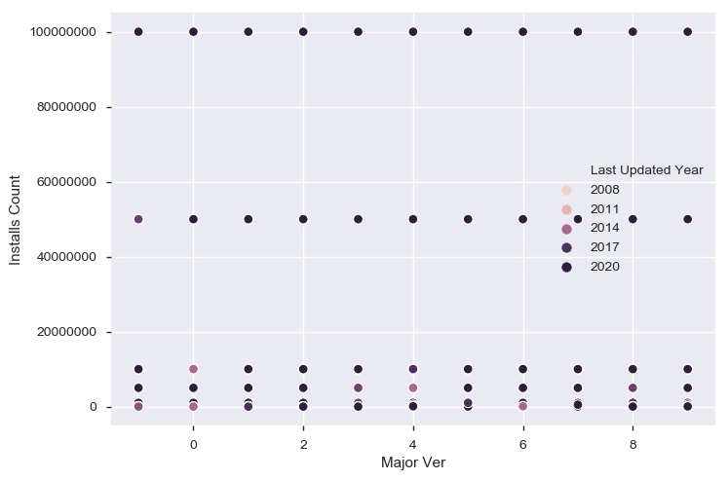
Influence of app maturity

Slide 12
Conclusions
Family safe apps have most number of downloads.
Free apps have most number of downloads compared to paid apps.
Most downloaded apps are from only 7 categories.
Apps have to be frequently updated, to be recommended on Google play store and to get more number of downloads.
Users don't mind to install apps with big size, when the content has quality.

